Slide 1
Type of College- Affiliated Address of College- Lodipur, Bind, Nalanda Year of Establishment- 2017 Name of University- MAULANA MAZHRUL HAQUE ARABIC & PERSION UNIVERSITY,PATNA
Monitoring Track No- 07
Presentation Date- 19/12/2023

Slide 2
Talent Pool and other information
Designation | Number/Status | Remarks
Principal | 1 | None
Principal in Charge | 0 | None
Bursar | 0 | None
Professors | 0 | None
Associate Professors | 0 | None
Asst. Professors | 31 | None
Guest Lecturers | 0 | None
Any other faculty | 0 | None
Is Intermediate education currently being conducted at the same college? | NO | None
Capacity to undertake examination on any given day in College | 400 | None

Slide 3
Institutional Information (1/2)
Sr No | Items | Total Course Offering* | Please mention authorization having from to run the courses
1 | No of traditional courses running | N/A
2 | No of self-financed courses running | 02 | B.Ed. & D.El.Ed. (NCTE & MMHA&P.University,Patna) (Authorization Session 2018-20)
3 | No of Internship/Apprenticeship Embedded Degree Programme being offered | N/A
4 | Number of courses being offered under SWAYAM | N/A
5 | The college is offering subjects for which students are enrolled, but there are no teachers available. | ( Please write subject and enrolment in the subject ):-NO
6 | Participated in NIRF 2023 Ranking | NO
7 | Registered for NIRF 2024 ranking | NO
8 | NAAC accreditation Status | NO
9 | In case no please explain status of preparation for NAAC | Preparation is undergoing
10 | Registration of college for N-LIST services | NO
11 | Participated AISHE survey 2021-2022 | YES

Slide 4
Institutional Information (2/2)
12 | Student Attendance( October Month | Total Enrolled | Total Present |  | Present %
6 | Student Attendance | (218) B.Ed. & D.El.Ed. | 130 |  | 77%
13 | Classroom | Total Classroom | Seating capacity |  | Remarks
 |  | 08 | 50 Per Classroom |  | N/A
14 | Library | Total Books | Total E Journal |  | Seating capacity
 |  | 4629 | 12 |  | 50 Per Classroom
15 | Hostel | Y/N | Total capacity |  | Total staying
 |  | YES | 100 |  | 0
16 | Bathroom | Total Male Toilet | Total Female Toilet |  | Total water pipeline Tab
 |  | 4 | 4 |  | 3
17 | Academic Collaboration with other HEIs | Total no Collaboration |  | Total Active Collaboration
 |  | None |  | None
18 | College has 2F and 12 B status ? | 2F |  | 12B | 12 B
15 |  | N/O |  | N/O
19 | College has active website | YES

Slide 5
Status of Video Conferencing/E lecture facilities
Principal office has Video Conferencing facilities | Bursar office has Video Conferencing facilities | Number of department having video conferencing facilities | Number of class/activities conducted through VC
YES | N/A | 2 | None

Slide 6
Availability of Computers in Colleges
Details | Programme Wise
 | UG | PG | Total | Remarks
Number of computer lab | 01 | N/A | 01 | None
Digital Board/smart screen (nos) | 0 | 0 | 0 | None
Number of computers | 25 | 0 | 25 | None
Student Computer Ratio | 1/9 | 0 | 1/9 | None
Number of fully functional computers available for students in the year 2023 | 21 | 0 | 21 | None

Slide 7
Please provide the number of labs and the average number of daily classes held in each lab (include details)
Type of Lab | No of LAB | No. of daily classes (average) taken | Percentage of students present
Physics Lab | 1 | 1 | 81%
Zoology Lab | 1 | 1 | 80%
Botany Lab | 1 | 1 | 78%
Psychology Lab | 1 | 1 | 79%
Chemistry Lab | 1 | 1 | 80%
Math Lab | 1 | 1 | 70%

Slide 8
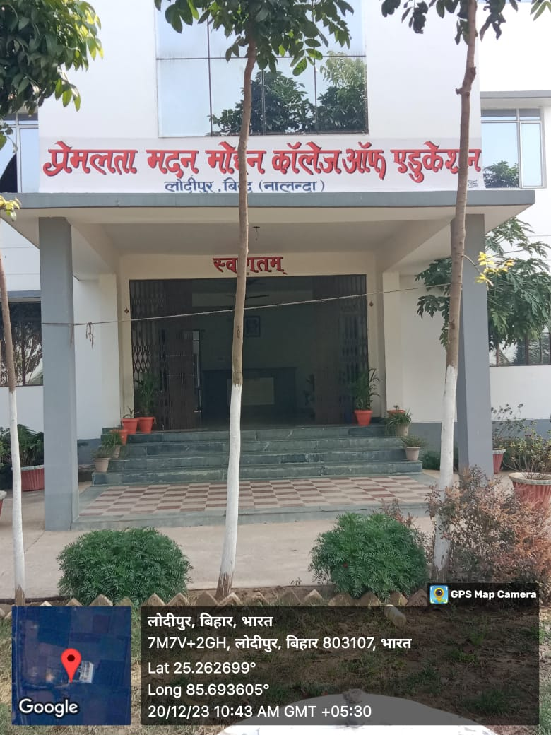
Photographs of Main Gate of College (Geo Tagged)

Slide 9
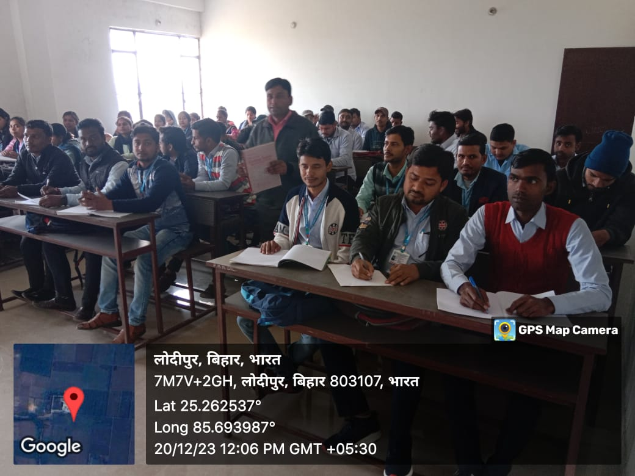
Photographs of Classroom of College (Geo Tagged)

Slide 10
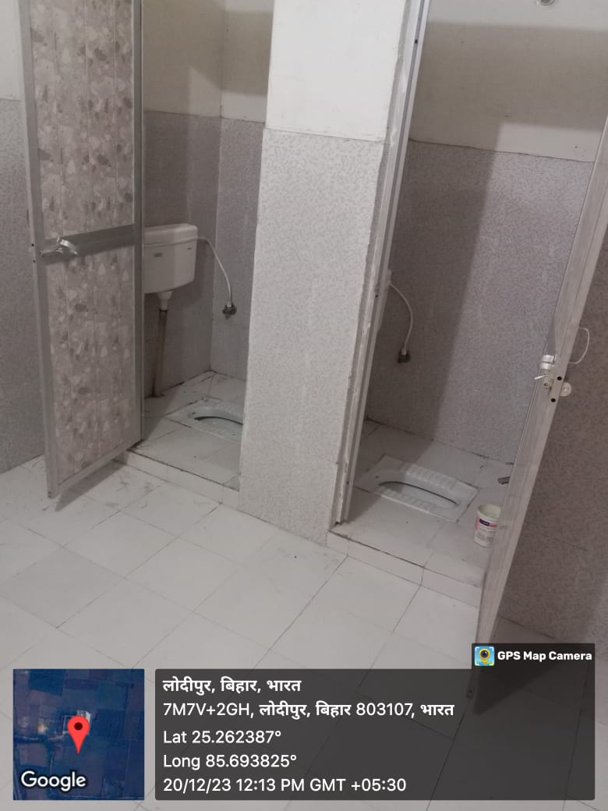
Photographs of toilets of College (Geo Tagged)

Slide 11
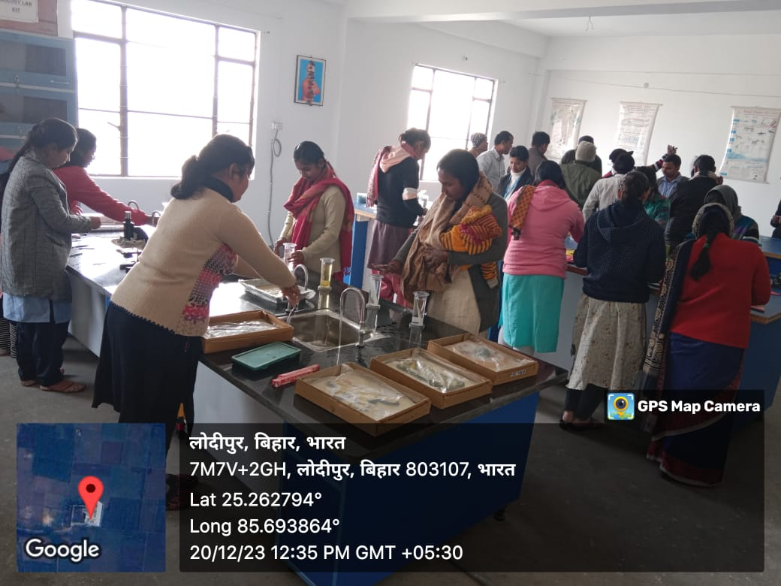
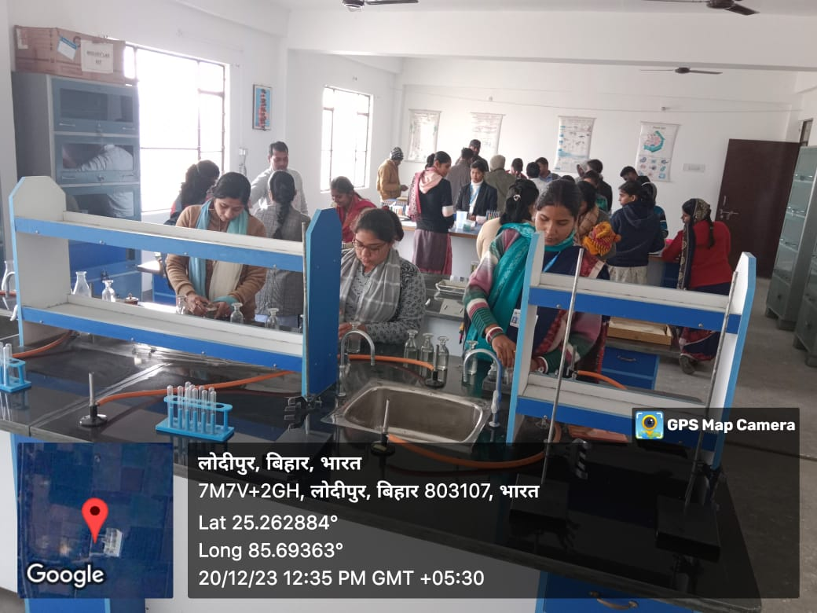
Photographs of Labs of College (Geo Tagged)

Slide 12
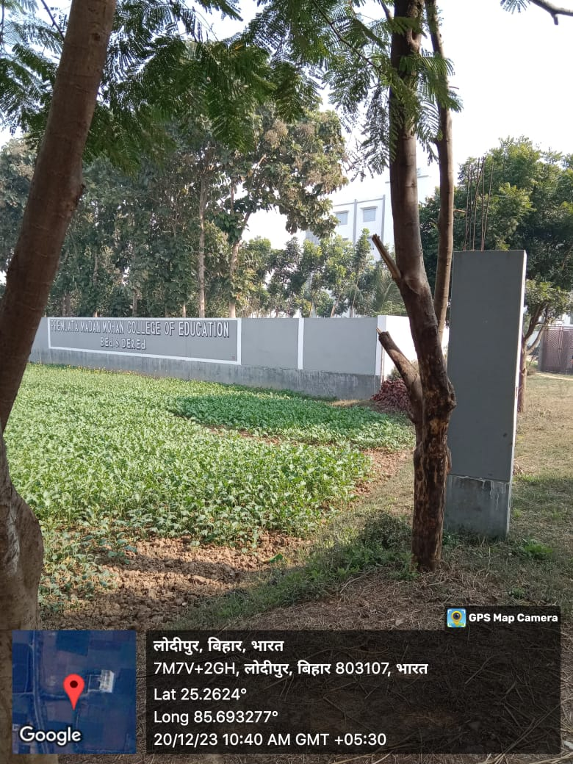
Photographs of Boundary wall of College (Geo Tagged)

Slide 13
Photographs of Website of College (Geo Tagged)

Slide 14
THANK YOU

